Slide 1
Intermediate Deterministic Models
Day 1
Spring 2021

Slide 2
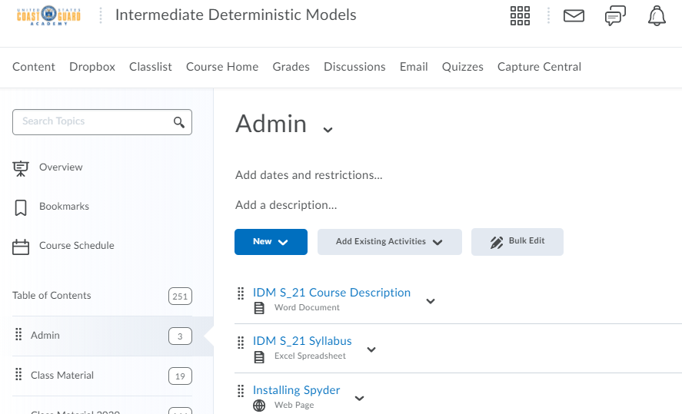
Course Documents
on D2L

Slide 3
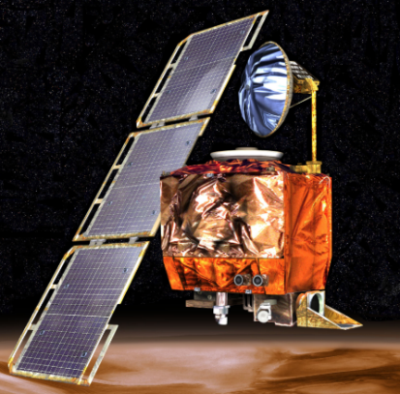
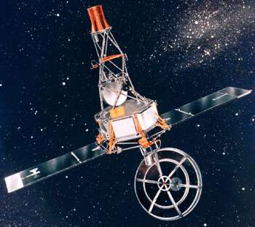
Attention to Detail
NASA Mars Climate Orbiter, 1998
$655-million robotic space probe
Burned up in Mars' upper atmosphere due to entering at wrong angle
Cause: use of wrong units (pound–seconds instead of newton–seconds) in software that ran thrusters
Mariner 1 Spacecraft, 1962
Veered off course minutes after launch
Potential for crash in North Atlantic shipping lanes or inhabited area
Cause: a missing hyphen in a data-editing computer program resulting in incorrect guidance signals
Source: http://www.vitalstatistics.info/uploads/mars%20climate%20orbiter.jpg
Source: https://www.edn.com/wp-content/uploads/media-1193429-mariner-1.jpg

Slide 4
Attention to Detail (cont.)
The Patriot Missile Failure, 1991
Gulf War US Patriot Missile battery in Saudi Arabia
Failed to track and intercept incoming Iraqi Scud missile
28 soldiers killed, 100 others injured
Cause: inaccurate calculation of time since computer boot-up
Truncation of a repeating decimal expansion led to a very small error that grew in time
Resulted in 0.34 second discrepancy, equivalent to over half a kilometer of Scud travel distance
Read more here: http://www-users.math.umn.edu/~arnold//disasters/patriot.html

Slide 5
For more on these examples and others:
https://www.scientificamerican.com/article/pogue-5-most-embarrassing-software-bugs-in-history/
https://en.wikipedia.org/wiki/Pentium_FDIV_bug
https://www.edn.com/mariner-1-destroyed-due-to-code-error-july-22-1962/
Six Tiny Scientific Mistakes That Created Huge Disasters | World Science Festival
The top 10 IT disasters of all time | ZDNet
11 of the most costly software errors in history [2019 update] · Raygun Blog
Great miscalculations: The French railway error and 10 others - BBC News

Slide 6
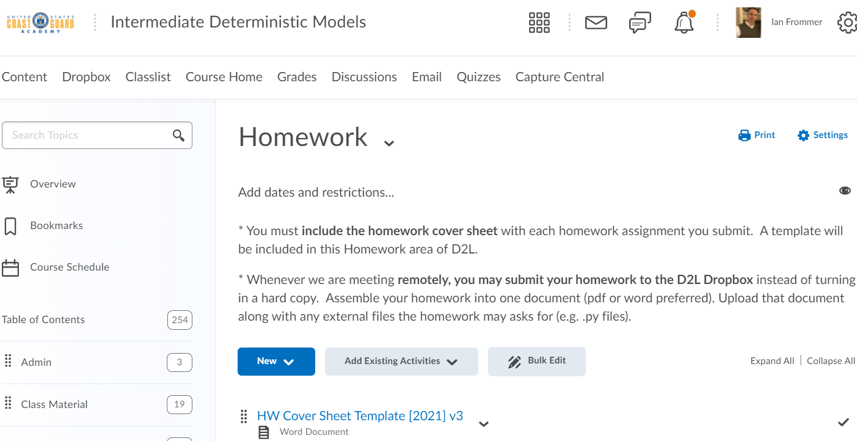
Course Documents
on D2L
and scroll down to see HW 1 assignment

Slide 7
Course Documents
on D2L

Slide 8
Python & PuLP

Slide 9
Python in Optimization Modeling
Python “lets you work quickly and integrate systems more effectively”
“integrate systems” – we will be integrating sets of data with optimization models and solvers to produce solutions
(src: python.org)
Python
Data
Data
Structures
Optimization Models
(PuLP & others)
Solvers
(COIN-OR & others)
Solutions

Slide 10
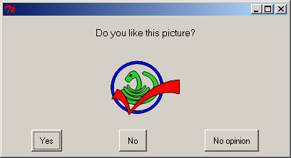
PuLP: a library for expressing mathematical programs (LPs, IPs, MIPs) in Python
Why use PuLP?
Flexibility in modeling thanks to Python setting
Python data structures and flow control
lists, dictionaries, etc.
not limited to what can be expressed in an Excel spreadsheet
Extensive set of Python for libraries capable of
reading in data
fetch information from the Internet
numerical procedures
creating GUIs
and much, much more …
(based on Mitchell (2009) and Mitchell (2011))

Slide 11
Why use PuLP? (cont.)
Model size only limited by solution time on our machine
Ease of installation (should be)
Non-restrictive licensing
Free
Can be used in commercial applications with no disclosure requirement
Clear syntax
Interoperability with many solvers, such as COIN-OR
- useful for comparisons; can easily step up to faster pay solvers later
Extensive documentation online

Slide 12
PuLP: bottom line
using PuLP we can solve large problems, maintaining confidentiality, for free
may come in handy in your Capstone and beyond
Note: it is provided “as is”, no warranty
** Read PuLP reference docs available on D2L. **

Slide 13
We will start by building a simple LP in PuLP
Problem Statement:
Blue Ridge Hot Tubs produces two types of hot tubs: Aqua-Spas & Hydro-Luxes.
Problem Data:
Aqua-Spa Hydro-Lux Available
Pumps 1 1 200
Labor 9 hours 6 hours 1566 hours
Tubing 12 feet 16 feet 2880 feet
Unit Profit $350 $300
Formulation
X₁=number of Aqua-Spas to produce X₂=number of Hydro-Luxes to produce
MAX: 350X₁ + 300X₂
S.T.: 1X₁ + 1X₂ <= 200
9X₁ + 6X₂ <= 1566
12X₁ + 16X₂ <= 2880
X₁ >= 0
X₂ >= 0
Let’s implement this in Python/PuLP!
Completed version will be on D2L : Class Material at 1600 called
hotTubBasic_FilledIn.py

